Slide 1
Convert from English to FOL
Circle True or False. For sentences in English make your judgment of the meaning of the sentence, i.e., you may want to translate it in FOL to conclude.
1. [True/False] "Bert and Ernie are brothers" is equivalent to "Bert is a brother and Ernie is a brother”
2. [True/False] “ p and q are not both true” is equivalent to “ p and q are both not true”
3. [True/False] “Neither p nor q” is equivalent to “both p and q are false”
4. [True/False] “Not all A’s are B’s” is equivalent to “∃x (A(x) ∧ ¬B(x) ) ”
5. [True/False] "MS students and PhD students are welcome to apply." is equivalent to “∀x [(M(x)∧P(x)) ⇒ Apply(x)]”
False
False
True
True
False

Slide 2
Convert from English to FOL
Questions 6 to 9: Attract is a relation from x to y, i.e., A(x,y) says that “x attracts y” or equivalently that “y is attracted by x”.
6. [True/False] “Everything attracts something”, where “something” means “something or other”, is equivalent to “∀x ∃y A(x, y) ”
7. [True/False] “Something is attracted by everything”, where “something” means “something in particular”, is equivalent to “∃y ∃x A( x, y) ”
8. [True/False] “Everything is attracted by something” ”, where “something” means “something or other”, is equivalent to “∃x ∀y A(x, y) ”
9. [True/False] “Something attracts everything”, where “something” means “something in particular”, is equivalent to “∃x ∃y A(x, y) ”
True
False
False
False

Slide 5
Problem Statement
Tony, Claude and Ellen belong to the Zymba Club. Every member of the Zymba Club is
either a skier or a mountain climber or both. No mountain climber likes rain, and all
skiers like snow. Ellen dislikes whatever Tony likes and likes whatever Tony dislikes.
Tony likes rain and snow.
We want to answer the following queries:
• Is there a member of the Zymba Club who is a mountain climber but not a skier?
• Who is it?

Slide 6
a. Translate the problem statement into FOL Sentences
(∀x) S(x) v M(x)
~(Ex) M(x) ^ L(x, Rain)
(∀x) S(x) => L(x, Snow)
(∀y) L(Ellen, y) <=> ~L(Tony, y)
L(Tony, Rain)
L(Tony, Snow)
Query: (Ex) M(x) ^ ~S(x)
Negation of the Query: ~(Ex) M(x) ^ ~S(x)

Slide 7
b. Convert to Conjunctive Normal Form
S(x1) v M(x1)
~M(x2) v ~L(x2, Rain)
~S(x3) v L(x3, Snow)
~L(Tony, x4) v ~L(Ellen, x4)
L(Tony, x5) v L(Ellen, x5)
L(Tony, Rain)
L(Tony, Snow)
Negation of the Query: ~M(x7) v S(x7)

Slide 8
c. Produce an answer to the first query using a Resolution
S(x1) v M(x1)
~M(x2) v ~L(x2, Rain)
~S(x3) v L(x3, Snow)
~L(Tony, x4) v ~L(Ellen, x4)
L(Tony, x5) v L(Ellen, x5)
L(Tony, Rain)
L(Tony, Snow)
Negation of the Query: ~M(x7) v S(x7)
Clause 1 Clause 2 Resolvent MGU
8 1 9. S(x1) {x7/x1}
9 3 10. L(x1, Snow) {x3/x1}
10 4 11.~L(Tony, Snow) {x4/Snow,x1/Ellen}
11 7 False {}
answer: Ellen

Slide 9
CSCI 561 Foundations of Artificial Intelligence Lecture 9: Knowledge representation (Chapter 12)
Summer 2017
Instructor: Prof. sheila tejada

Slide 10
Knowledge Representation
(Creation of) internal structures representing external objects, properties, relations, activities, etc.
Represent world in syntax of KR language
Decide what needs to be represented
Decide what distinctions need to be made
The ontology/conceptualization/categorization
What are the distinct objects, properties, relations, etc.
Select a representation language
May vary widely in terms of formality/precision
Natural language, semi-structured web pages, frames, semantic networks, rules, differential equations, logic
Encode knowledge in language based on ontology
Are there general principles for doing this for kinds of K?
Reason with encoded knowledge

Slide 11
Ontology
What are the basic concepts/categories needed to describe reality?
Time, space, things, ideas, actions, …
How are concepts defined and distinguished?
Properties, relations, rules, …
How do these concepts relate to each other?
Relations such as Subclass define hierarchies
How do objects relate to categories?
Objects are members of categories
How do we reason about objects and categories?
Inference, inheritance, …
Notes:
Not just type hierarchies
Look at the answers to these kinds of questions

Slide 12
Defining Concepts/Categories
Explicit set of members
E.g., MajorPoliticalParties = {Dem, Rep}
or necessary and sufficient conditions
Inverter = Logic gate that inverts a signal
TextBook = Book used in a course
Works better for man-made concepts than natural kinds
Bird = Animal that has feathers and flies
Tomato = Acidic red fruit
Mammal = Warm blooded animal that gives birth to live young
or nearness to a prototype (typical member)
Prototypical bird has feathers, flies, lays eggs, …
Prototypical tomato is acidic, red, a fruit…
May divide features into necessary and typical
E.g., all tomatoes are fruits
Logic is best at dealing with first two
Other approaches, e.g., fuzzy, prob., prototypes deal with third
Notes:
Ostrich, heirloom tomatoes, platypus

Slide 13
Defining Categories in Logic
Necessary conditions (C ⇒ P)
E.g., ∀x Basketball(x) ⇒ Round(x)
Sufficient conditions (P ⇒ C)
E.g., ∀x Suit(x)=Spades ∧ Blips(x,1) ⇒ Ace(x)
Necessary and Sufficient Conditions (P ⇔ C)
E.g., ∀x Contains(x, Carbon) ⇔ Organic(x)
E.g., ∀x x ∈ {Dem, Rep} ⇔ MajorPoliticalParty(x)

Slide 14
More on Representing Categories in Logic
Can represent a category as a unary predicate
E.g., Basketball(x), Ace(x), Organic(x)
Category is viewed as a property of object x
Or can represent category as an object itself
Basketballs, Aces, OrganicCompounds
Called reification
Turning a fact into an object about which facts can be stated
E.g., NumberOf(Aces)=4
Category membership looks different in two cases
Basketball(B₁) vs. B₁ ∈ Basketballs
Subclass definition also differs
∀x Ace(x) ⇒ Card(x) vs.
Aces ⊂ Cards (or Aces ⊆ Cards)

Slide 15
Type Hierarchies
Subclasses implicitly define a type hierarchy
Also referred to as an ontology, a taxonomy, or a taxonomic hierarchy
Animals
Fish
Amphibians
Reptiles
Birds
Mammals
Robins
Eagles
Ostriches
Penguins

Slide 16
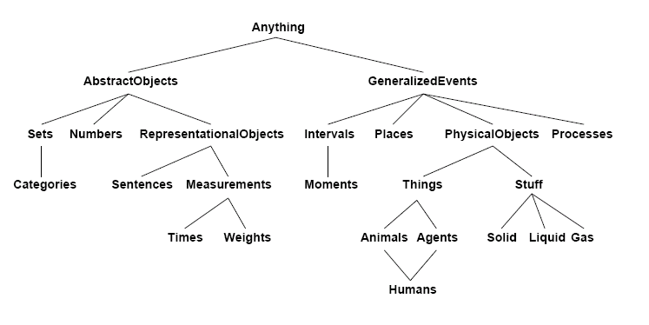
Upper Ontology of World
Several projects have tried to build generic upper ontologies to which domain specific ontologies can then be attached as needed
Notes:
Generating a good upper ontology is tough, with subtle distinctions to be made

Slide 17
Inheritance
One of the most critical forms of inference enabled by type hierarchies is inheritance
If an object is a member of a class, and all members of the class share some property, then the object will have that property
E.g., if all balls can bounce, and B₁ is a ball, then we can conclude that B₁ can bounce
Inheritance can occur from any superclass
E.g., if object A₁ is an element of the class Apples, Apples is a subclass of Fruit, Fruit is a subclass of Food, and all Food is edible, then A₁ is edible
Edible
Food
Fruit
Apples
A₁

Slide 18
Multiple Inheritance
What happens when multiple superclasses yield different answers?
Tweety
Birds can (generally) fly, but penguins can’t
Can Tweety fly if s/he is a penguin?
Take the lowest answer in a chain (override defaults)
Nixon
Quakers are pacifists while republicans are warlike
Nixon was a republican Quaker
Was Nixon a pacifist or warlike?
No way to decide unless prioritize
Fly
Birds
Penguins
Tweety
Pacifist
Republicans
Quakers
Nixon

Slide 19
Beyond Monotonicity in Logic
Propositional and first-order logic are monotonic
As new sentences α are added to KB what is entailed can never decrease
If S = {s | KB ╞ s} and A = {a | KB+α ╞ a} then S ⊆ A
Non-monotonic logic eliminates this restriction
If Tweety is a bird and birds fly conclude Tweety flies
If then told penguins don’t fly and that Tweety is a Penguin need to retract conclusion that Tweety flies
Or can keep KB in FOL while altering the KB extra-logically, as needed
Belief revision via a truth maintenance system (TMS)

Slide 20
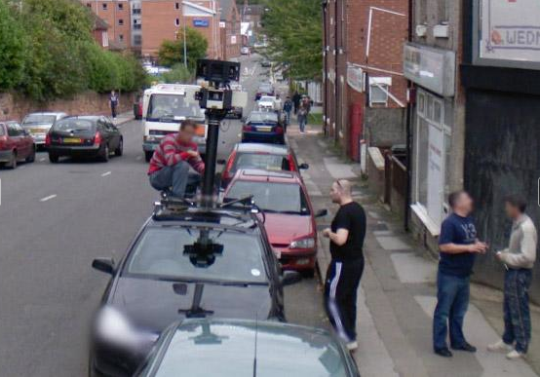

Objects
Members of concepts/categories
E.g., ∈ People, Tweety ∈ Penguins
Have properties and participate in relations with other objects, for example:
Physical objects have measurements
Size, weight, etc.
Physical objects may be discrete or continuous
Count versus mass nouns
Many kinds of objects are composites
Built out of structured combinations of more primitive objects
Time and space can be thought of as objects w/ extents
Notes:
Measurement: chair
Count vs mass: marbles versus peanut butter
Cars are built out of wheels and axles
Go through each of these in turn

Slide 21
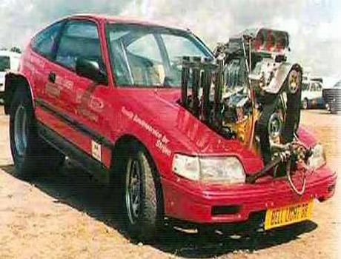
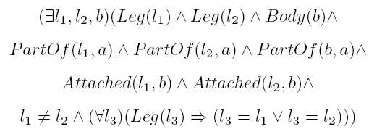
Physical Composition
For individuals, one object may be
part of another:
PartOf(Piston₁,Cylinder₁)
PartOf(Cylinder₁,Engine₁)
PartOf(Engine₁,Car₁)
PartOf is transitive, so can infer PartOf(Piston₁,Car₁)
∀ x,y,z PartOf(x,y) ∧ PartOf(y,z) ⇒ PartOf(x,z)
Often characterized by structural relations among parts
E.g. ∀ a Biped(a) ⇒
Necessary or sufficient?
Notes:
Not sure why it makes sense semantically for PartOf to be reflexive

Slide 22
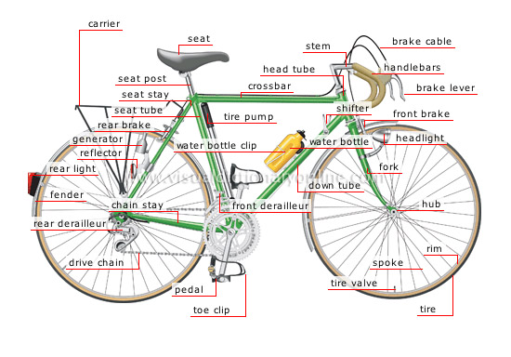
PartOf Hierarchies
As with subclasses, the PartOf relation
induces hierarchies, but of objects
Although can develop a comparable relationship between categories, for example:
CategoryPartOf(Pistons, Engines) could represent that ∀x x ∈ Engines ⇒ ∃y y ∈ Pistons ∧ PartOf(y,x)
Bicycle₁
Seat₁
Frame₁
DriveTrain₁
HandleBar₁
Gears₁
Chain₁
Wheel₁
Wheel₂

Slide 23
Putting it all together…
Suppose you want to build a system to diagnose problems with your car….
Representing the car:
Probably a “kind” hierarchy to represent the car
And a “part of” hierarchy to represent the parts of the car and it’s components
What can we leave out? E.g. TIME is important in some domains but not others;
“Recent trip to Africa” important in some medical apps;

Slide 24
Putting it all together…
More decisions: Faults
Represent faults explicitly:
As distinct unstructured states: bad-spark-plug; dead-battery; low-battery
As structured objects in FOL: defective(spark-plug); dead(battery); low-voltage(battery)
=> is simpler, but fails to capture relations;
Have a working model of the car; faults are perturbations to that model; e.g. like a simulation; introduce faults in model and derive consequences
=> more complex, but potentially more robust

Slide 25
Putting it all together…
(Yet) more decisions:
Diagnosis process:
Heuristic classification: all faults pre-enumerated
- everything must be anticipated in advance
Model-based diagnosis: derive faults from simulated behavior of model
- more complex but can diagnose novel problems (in principle)

Slide 26
Knowledge Sharing effort
See “Enabling Technology for Knowledge Sharing” Neches et al.
Problems:
Building a KB is difficult & expensive
Each system starts from scratch
What if a KB could be shared and re-used?

Slide 27
Impediments to sharing
Different KR languages (logic, semantic nets, etc)
Different dialects of KR languages even within a “family”
Description logics: LOOM, CLASSIC, NIKL
Lack of communication conventions
Model mismatches at the knowledge level
KB1 KB2
THING
THING
CONCRETE
THING
LIVING
THING
INANIMATE
THING
ABSTRACT
THING
ANIMAL
ANIMAL

Slide 28
KNOWLEDGE SHARING: 4 EFFORTS
Interlingua – Knowledge Interchange Format (KIF)
Translate from KB1 to intermediate language then to KB2
KB1 => KIF => KB2
KIF designed to support translation, not inference
Knowledge Representation System Specification
Create “standard” specification for KR language within a particular family of languages (e.g. description logics)

Slide 29
KNOWLEDGE SHARING: 4 EFFORTS
Standardized Query Interface
Share across KBs by querying from one KB to the other (as in databases)
Knowledge not moved from one to the other
Shared, Reusable Knowledge Bases
Create a common “upper” ontology that can form the basis for many knowledge based systems

Slide 30
Vision

Slide 31
RESULTS
Knowledge Interchange Format (KIF)
Expressiveness of KIF an issue – needs to be able to represent everything or information is lost
Translators difficult to automate
Knowledge Representation System Specification
Target spec produced; but most KR languages still had extensions
Nevertheless, forced discussion about KR issues
External interfaces
KQML – Knowledge Query and Manipulation Language used in a number of systems

Slide 32
RESULTS
Shared Reusable Knowledge Bases
Brought attention to the value of shared ontologies
A number of large-scale “upper” ontologies have been created (see text)

Slide 33
Possible KRR approaches
Knowledge engineering
Write down all of the necessary knowledge in a manner that supports automated inference
Semantic web
Distribute the knowledge engineering task across the entire world, supported by international standards for encoding knowledge
Knowledge extraction
Find knowledge in natural language text (e.g. social media), and convert it into a representation that supports automated reasoning
Experiential learning
Build a robot that can learn the knowledge by interacting with the world, just like a human child does

Slide 34
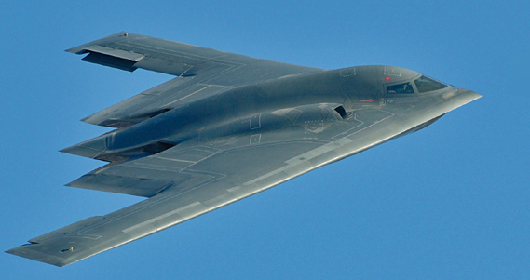
Approach 1: Knowledge Engineering
Now that we all know logic, let’s just write down what we need.
1,000,000,000 axioms ÷ 350 CSCI 561 students
2,857,142 axioms/student ÷ 50 good axioms per workday
57,142 workdays/student ÷ 200 workdays a year
285 years/student
Cost @ $100K salary including facilities and benefits = ~$10B
~$10B

Slide 35
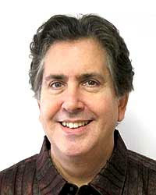
Cyc
Idea: Focus on getting the first million axioms right, so that the computer can learn the rest by reading texts, e.g. by reading the encyclopedia.
Project started in 1984 by Doug Lenat. First envisioned to be a 350 person-year effort. Still operating out of Austin, TX.
Represents knowledge in stylized first-order logic.
Cyc knowledge base: Over one million hand-authored rules.
OpenCyc 4.0: Focuses on the concepts and relations.
If you think Cyc is a good idea, then don’t do Knowledge Engineering, because Cyc will eventually prove you are right.
If you think that Cyc is a bad idea, then don’t do Knowledge Engineering, because Cyc will eventually prove you are right.
Doug Lenat
CEO of Cycorp, Inc.
big project paradox

Slide 36
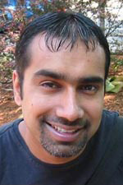

OpenMind Common Sense
Idea: Crowdsource the knowledge engineering task to tens of thousands of volunteers on the web, and give them easy-to-use templates.
More than 1 million facts collected from over 15,000 contributors. Knowledge represented in a semantic network “ConceptNet”.
A coat is used for keeping warm
The sun is very hot
The last thing you do when you cook dinner is wash your dishes
Spending time with friends causes happiness
Getting into a car wreck makes one angry
People want to be respected
People want good coffee
Push Singh
1972-2006
MIT Media Lab

Slide 37
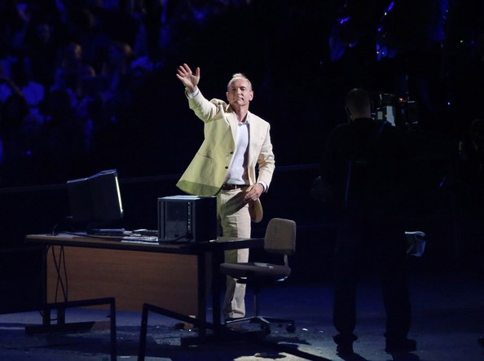
Approach 2: Semantic Web
Instead of writing down knowledge ourselves, let’s distribute the knowledge engineering task across the entire world, supported by international standards for encoding knowledge.
I have a dream for the Web [in which computers] become capable of analyzing all the data on the Web – the content, links, and transactions between people and computers. A "Semantic Web", which makes this possible, has yet to emerge, but when it does, the day-to-day mechanisms of trade, bureaucracy and our daily lives will be handled by machines talking to machines. The "intelligent agents" people have touted for ages will finally materialize. (Berners-Lee, 1999)
Tim Berners-Lee
Inventor of the web
2012 Olympics opening ceremony

Slide 38
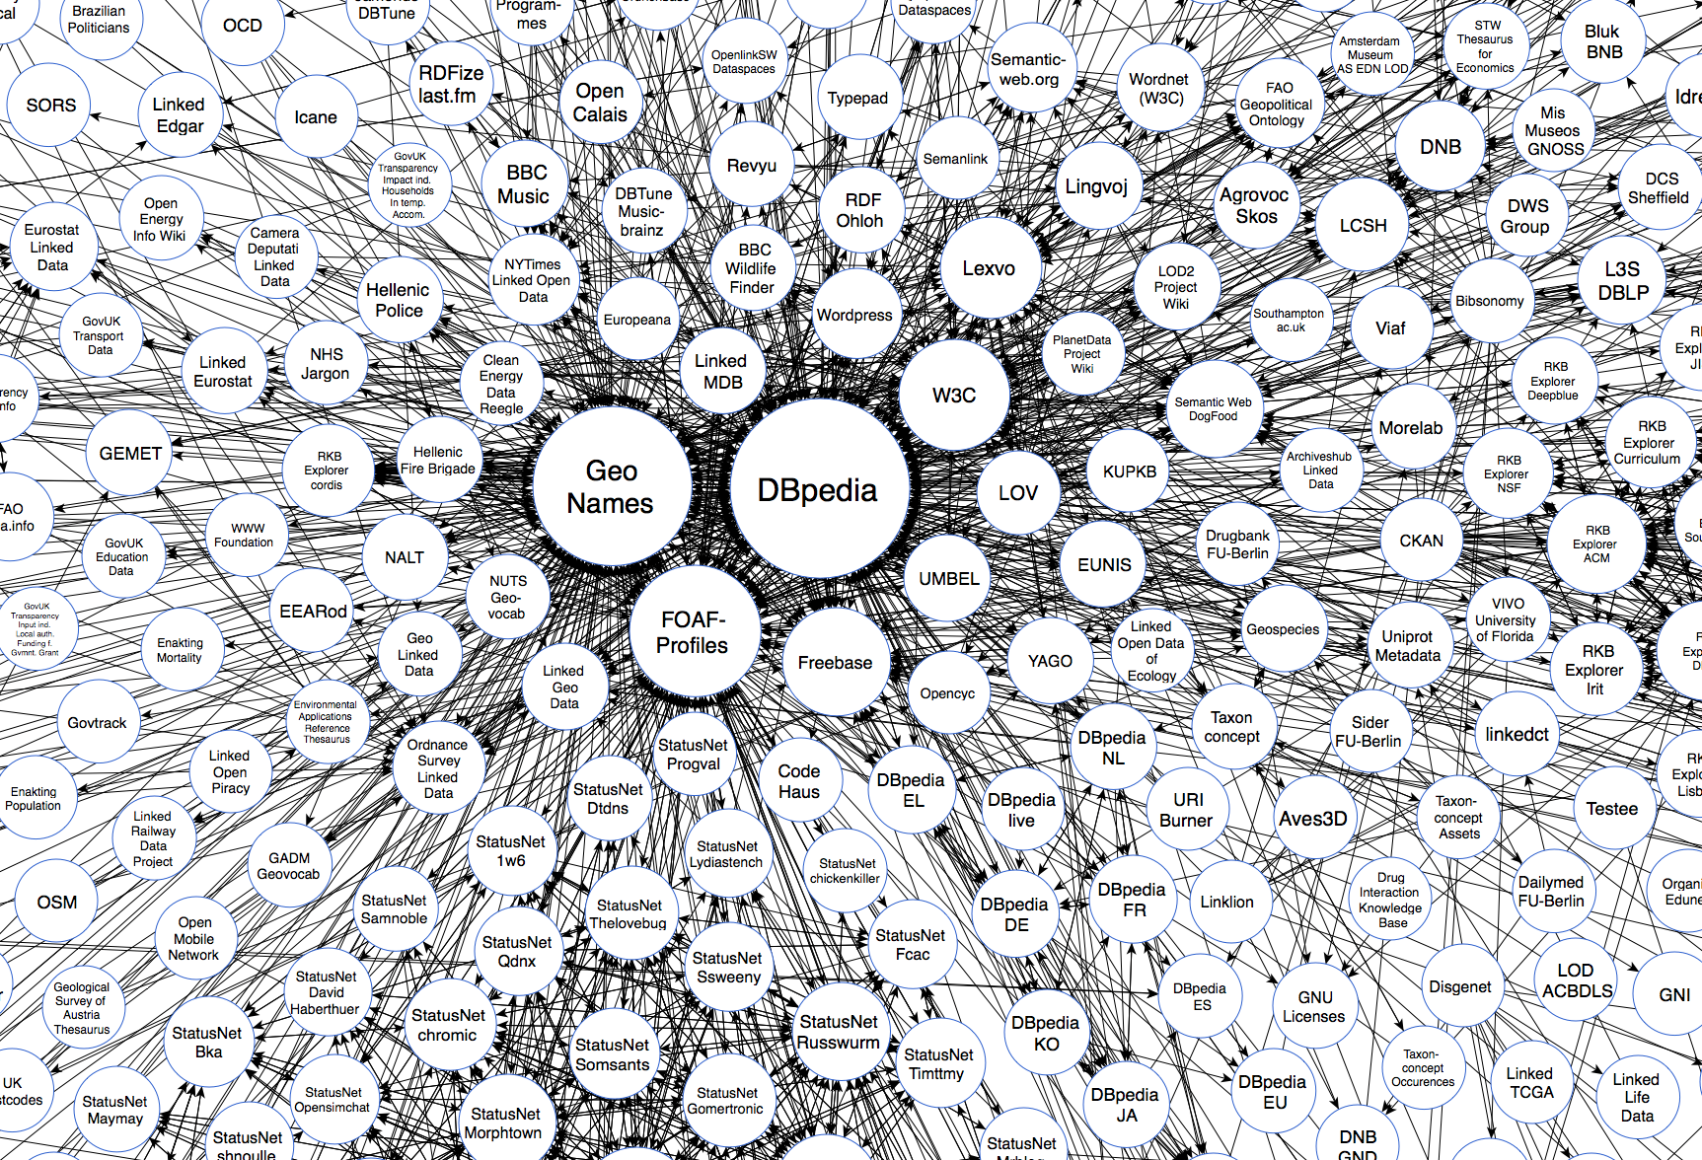

Slide 39
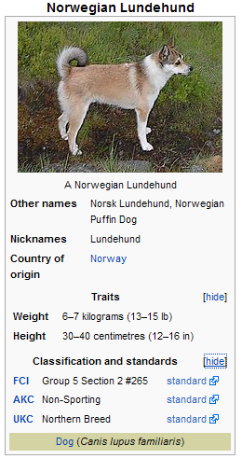
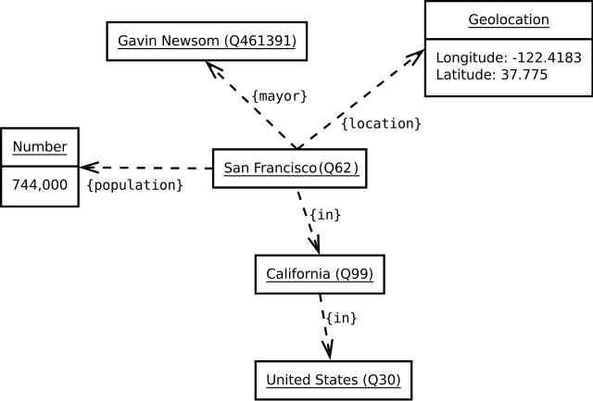
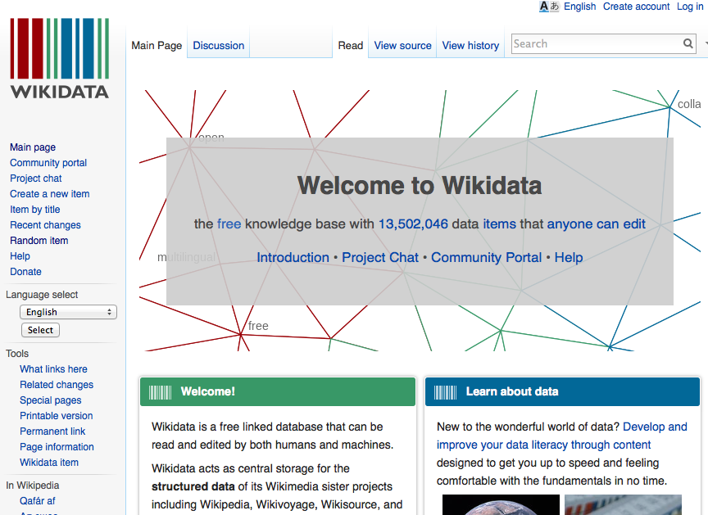
WikiData
A hand-authored Semantic Network of unique concepts linked via defined relations.
The information you would find in Wikipedia’s InfoBoxes
Similar to Google’s internal “Knowledge Graph”

Slide 40
Approach 3: Knowledge extraction
The most natural way for people to express their knowledge is through natural language. Let’s just convert natural language into axioms.
Text sources:
Every book in Project Gutenberg
Every webpage on the web
Every Blogspot post, Twitter tweet, Amazon review
Every query submitted to Google
Every email in Gmail

Slide 41
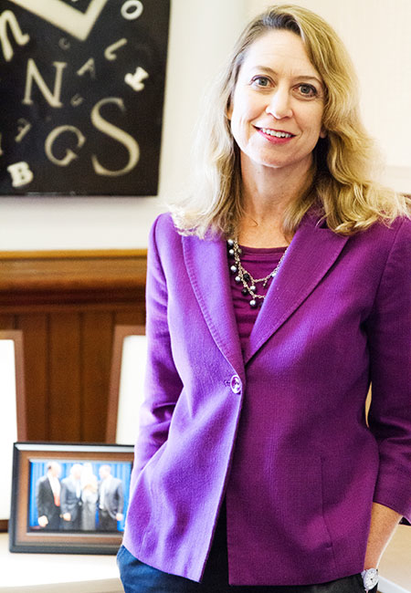
Hearst Patterns
The presence of certain “lexico-syntactic patterns” can indicate a particular semantic relationship between two nouns.
Example:
“such NP_{y} as NP_{x}…” ⋁ such teams as the Cubs… “NP_{x} and other NP_{y}…” ⇒ The Cubs and other teams…
NP_{x} is is a hyponym of Np_{y} The Cubs is a type of Team
The bow lute, such as the Bambara ndang, is plucked and has an individual curved neck for each string.
⇒
hyponym(“Bambara ndang”, “bow lute”)
Prof. Marti Hearst UC Berkeley
Automatic acquisition of hyponyms from large text corpora (1992)

Slide 42
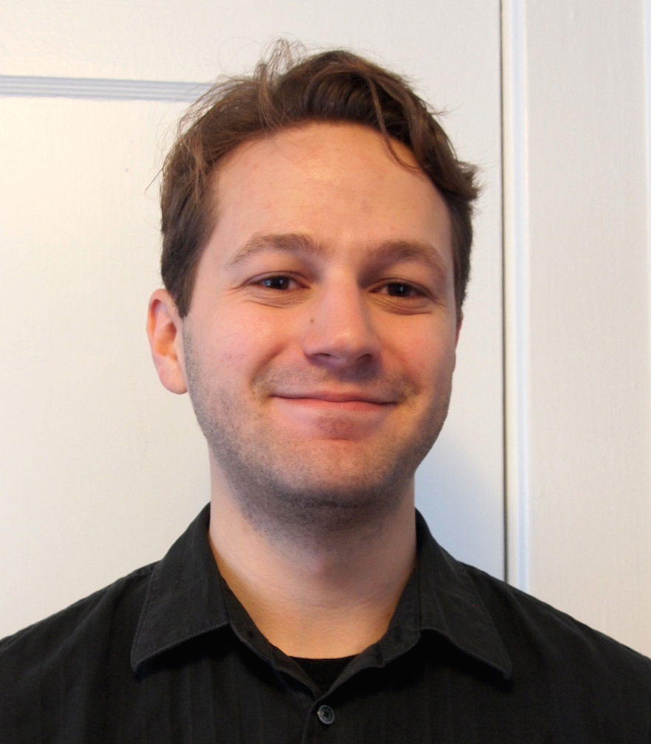
Commonsense axioms from text
Presuppositions: “Both my legs hurt.” ⇒ A person normally has two legs.
Disconfirmed expectations: “I dropped the glass but it didn’t break.” ⇒ If a person drops a glass, it often will break.
Implicit denials: “The tree had no branches.” ⇒ Trees usually have branches.
Reference to individuals: “…the man I met yesterday.” ⇒ A person may meet a man.
Jonathan Gordon USC-ISI Postdoc
Inferential Commonsense Knowledge from Text (2014)

Slide 43
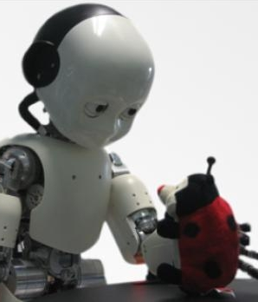
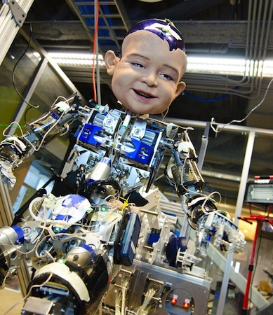
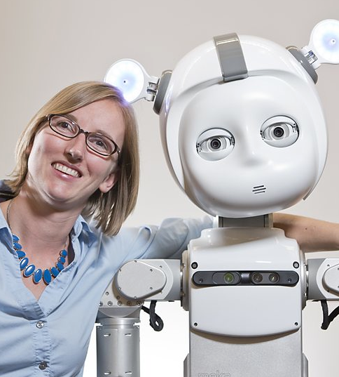
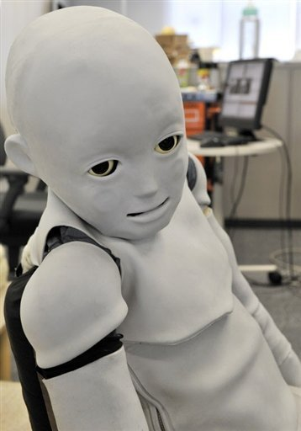
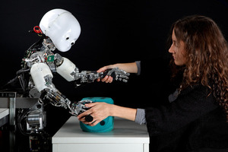
Approach 4: Experiential learning
Encoding all of this knowledge is too hard. Let’s just build a robot baby and write an algorithm for it to learn from its experiences in the world.
U. Twente
UCSD
GA Tech
Osaka U.
Northwestern U.
We’re going to need a better understanding of how people learn from experience.

Slide 44
Want More?
Check out some of these exercises in the book:
12.2-3,7

